Slide 1

ReCG: Bottom-Up JSON Schema Discovery Using a Repetitive Cluster and Generalize Framework
August 28th, 2024
Joohyung Yun, Byungchul Tak, Wook-Shin Han
POSTECH

Slide 2






Welcome to JSON World
Data exchange
{
“id”: “joohyung_1”, “pswd”: “1234”,
”info”: {“age”: 23, “gender”: “male”}
}
JavaScript Object Notation (JSON)
AI & data analysis
Data storage & query

Slide 3
Welcome to JSON World
PEOPLE
High degree of freedom in data modeling
Problem: An accompanying schema is often absent!
id | pswd
joohyung_1 | 1234
wook-shin_2 | qwer
byungchul_3 | asdf
id | pswd
joohyung_1 | 1234
wook-shin_2 | qwer
{“id”: “joohyung_1”, “pswd”: “1234”,
”info”: {“age”: 23, “gender”: “male”}}
{“id”: “wook-shin_2”, “pswd”: “qwer”,
”info”: {“age”: 52, “gender”: “male”}}
INFO
id | age | gender
joohyung_1 | 23 | male
wook-shin_2 | 52 | male
{“id”: “byungchul_3”, “pswd”: “asdf”,
”info”: {“degree”: “PhD”, “place”: “KNU”}}
ANOTHER_INFO
id | degree | place
byungchul_3 | PhD | KNU

Slide 4





JSON Schema
JSON Schema
JSON document
validation
Data analytics
JSON parsing
acceleration
Data migration

Slide 5



JSON Schema: JSON Document Validation
JSON
document
rejected
JSON validator

Slide 6
JSON Schema Discovery
JSON schema
JSON documents

Slide 7
Background JSON Document and Tree Representation
For visibility, we express a JSON document with a node-labeled, node-typed, edge-labeled tree called an instance tree.
6 data types in total
{
“id”: “jhyun”,
“info”: [2000, true, null]
}
id
info
“jhyun”
An example JSON document
2000
true
null
An equivalent instance tree

Slide 8
Background JSON Document and Tree Representation
Primitive type document is
one of string, number, boolean, null.
expressed with a primitive-typed node with its value as label.
{
“id”: “jhyun”,
“info”: [2000, true, null]
}
id
info
“jhyun”
2000
true
null

Slide 9
Background JSON Document and Tree Representation
Array type document is
a sequence of elements (JSON documents).
expressed with an array-typed node with elements as ordered children.
{
“id”: “jhyun”,
“info”: [2000, true, null]
}
id
info
“jhyun”
element
element
element
2000
true
null
element
element
element

Slide 10
Background JSON Document and Tree Representation
Object type document is
a set of key, value (JSON document) pairs.
expressed with an object-typed node with keys as edge labels and values as unordered children.
key
value
{
“id”: “jhyun”,
“info”: [2000, true, null]
}
key
id
info
key
value
“jhyun”
value
key
value
2000
true
null

Slide 11
Background JSON Schema
JSON schema
Either accepts or rejects a JSON document
Imposes constraints to JSON documents
Is recursively defined

Slide 12
Background JSON Schema and Tree Representation
Primitive type schemas trivially impose JSON documents to be a document of corresponding type.

Slide 13
Background JSON Schema and Tree Representation
Primitive type schemas trivially impose JSON documents to be a document of corresponding type.
String schema
id
info
accepted by
“jhyun”
STR
2000
true
null

Slide 14
Background JSON Schema and Tree Representation
Primitive type schemas trivially impose JSON documents to be a document of corresponding type.
String schema, number schema
id
info
“jhyun”
STR
accepted by
2000
true
null
NUM

Slide 15
Background JSON Schema and Tree Representation
Primitive type schemas trivially impose JSON documents to be a document of corresponding type.
String schema, number schema, boolean schema
id
info
“jhyun”
STR
accepted by
2000
true
null
NUM
BOOL

Slide 16
Background JSON Schema and Tree Representation
Primitive type schemas trivially impose JSON documents to be a document of corresponding type.
String schema, number schema, boolean schema, null schema
id
info
“jhyun”
STR
accepted by
2000
true
null
NUM
BOOL
NULL

Slide 17
Background JSON Schema and Tree Representation
Array schemas additionally impose constraints on the number and schemas of elements.
id
info
accepted by
ARR
“jhyun”
STR
2000
true
null
NUM
BOOL
NULL

Slide 18
Background JSON Schema and Tree Representation
Array schemas additionally impose constraints on the number and schemas of elements.
Homogeneous array schema constrains arrays to have
Fixed length
Fixed subschema for element at each index
id
info
accepted by
ARR
ARR
“jhyun”
STR
2000
true
null
NUM
BOOL
NULL

Slide 19
Background JSON Schema and Tree Representation
Array schemas additionally impose constraints on the number and schemas of elements.
Heterogeneous array schema constrains arrays to have
Random lengths
Fixed single subschema for every element
id
info
accepted by
ARR
“jhyun”
STR
*
*
ANYOF
ANYOF
2000
true
null
NUM
BOOL
NULL

Slide 20
Background JSON Schema and Tree Representation
Object schemas additionally impose constraints on each keys and schema of each values.
accepted by
OBJ
id
info
ARR
“jhyun”
STR
*
ANYOF
2000
true
null
NUM
BOOL
NULL

Slide 21
Background JSON Schema and Tree Representation
Object schemas additionally impose constraints on each keys and schema of each values.
Homogeneous object schema constrains objects to have
Homogeneous keys (either required or optional)
One subschema per key
required
accepted by
rejected by
OBJ
optional
id
nickname
id
nickname
info
info
ARR
“jhyun”
“hyung”
STR
STR
*
ANYOF
2000
true
null
NUM
BOOL
NULL

Slide 22
Background JSON Schema and Tree Representation
Object schemas additionally impose constraints on each keys and schema of each values.
Heterogeneous object schema constrains objects to have
Heterogeneous keys & random number of key-value pairs
Same subschema for every value
OBJ
accepted by
*
ANYOF
bar
id
foo
info
ARR
“jhyun”
“beef”
STR
*
ANYOF
true
2000
true
null
NUM
BOOL
NULL

Slide 23
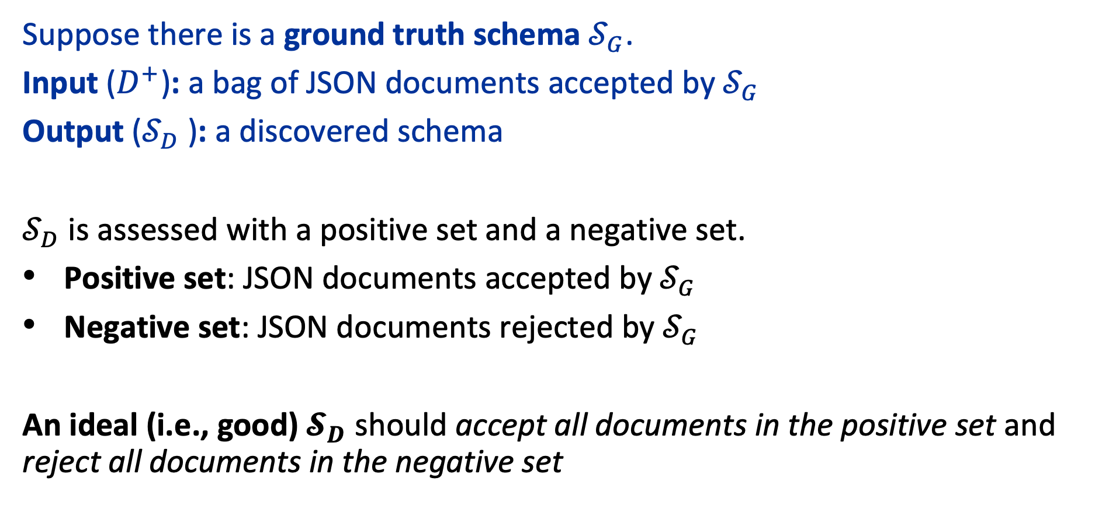
JSON Schema Discovery Problem
Suppose there is a ground truth schema $𝒮_{G}$.
Input ($D^{+}$): a bag of JSON documents accepted by $𝒮_{G}$
Output ($𝒮_{D}$): a discovered schema
$𝒮_{D}$ is assessed with a positive set and a negative set.
Positive set: JSON documents accepted by $𝒮_{G}$
Negative set: JSON documents rejected by $𝒮_{G}$
An ideal (i.e., good) $𝓢_{D}$ should accept all documents in the positive set and reject all documents in the negative set

Slide 24





Challenges of JSON Schema Discovery
Innumerable candidates of schemas that can be derived
Ambiguity in picking the best schema among the candidates
We do not have access to positive and negative set while deriving $𝒮_{D}$.
$$𝒮_{1}$$
ANYOF
$$𝒮_{3}$$
OBJ
$$𝒮_{2}$$
OBJ
$$D^{+}$$
*
OBJ
OBJ
id
name
ANYOF
pswd
id
name
id
pswd
id
name
id
pswd
NUM
STR
STR
2023
“Yun”
2019
“qwer”
NUM
STR
NUM
STR
NUM
STR
Specific
General

Slide 25

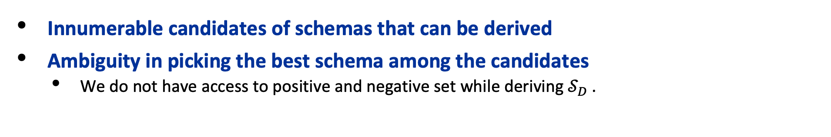

Challenges of JSON Schema Discovery
Innumerable candidates of schemas that can be derived
Ambiguity in picking the best schema among the candidates
We do not have access to positive and negative set while deriving $𝒮_{D}$.
What if there are many, highly nested JSON documents?
$$D^{+}$$
type
id
claims
type
id
aliases
type
id
claims
title
“item”
“Q147”
“item”
“Q732”
“item”
“Q117”
“Q117”
P373
P279
Ru
P31
P361
P17

Slide 26

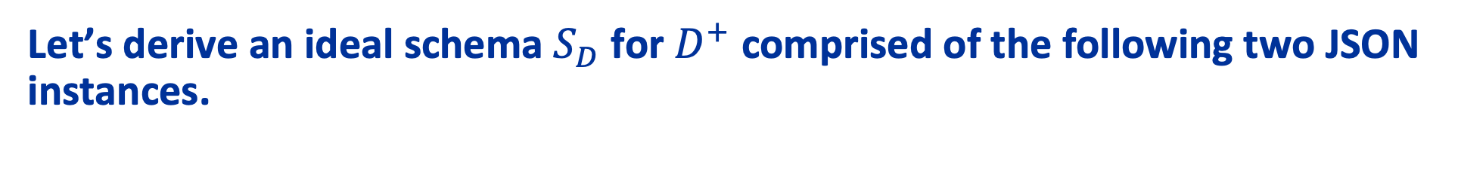
Global Example
Let’s derive an ideal schema $S_{D}$ for $D^{+}$ comprised of the following two JSON instances.
$$D^{+}$$
id
pswd
info
name
info
“jhyun”
“qwer”
“wshan”
age
gender
age
gender
email
23
“male”
52
“male”
“w@a.com”

Slide 27
Motivation 1: Insufficient Information to Derive Schema
Existing works derive schema in a top (root) – down (leaf) manner.
Information may be insufficient to correctly derive a schema
Schemas of children instances are not derived.
id
pswd
info
name
info
Same schema
“jhyun”
“qwer”
“wshan”
Different schema
age
gender
age
gender
email
age
gender
age
gender
email
23
“male”
52
“male”
ANYOF
23
“male”
52
“male”
null
“w@a.com”
OBJ
OBJ
OBJ
id
pswd
name
info
Ambiguous!
id
pswd
info
name
info

Slide 28
Key Idea 1: Bottom-up Schema Generation
We propose deriving schema in a bottom-up manner.
Previously derived schema nodes provide information for correct schema derivation.
Similar
id
pswd
info
name
info
STR
STR
OBJ
Similar
STR
OBJ
Schema
derivation
order
“jhyun”
“qwer”
“wshan”
age
age
gender
email
age
gender
email
gender
age
gender
email
NUM
NUM
STR
STR
NULL
NUM
STR
STR
NUM
STR
STR
23
“male”
52
“male”
“w@a.com”

Slide 29
Motivation 2: Many Candidate Derivations
In most cases, it may be ambiguous to pick one set of schemas to derive.
id
pswd
info
name
info
“jhyun”
“qwer”
“wshan”
age
gender
age
gender
email
NUM
STR
NUM
STR
STR
id
pswd
info
name
info
id
pswd
info
name
info
id
pswd
info
name
info
STR
STR
OBJ
STR
OBJ
STR
STR
OBJ
STR
OBJ
STR
STR
OBJ
STR
OBJ
*
*
age
gender
age
gender
email
age
gender
email
age
gender
email
ANYOF
ANYOF
NUM
STR
NUM
STR
STR
NUM
STR
STR
NUM
STR
STR
NUM
STR
NUM
STR
Most specific
Moderate
Most general

Slide 30
Key Idea 2: Candidate Schema Exploration
ReCG explores multiple schema derivation candidates rather than settling on just one.
State
: a bag of partially
derived schemas
id
pswd
info
name
info
“jhyun”
“qwer”
“wshan”
age
gender
age
gender
email
NUM
STR
NUM
STR
STR
Transition
: deriving schema nodes
of an upper level
id
pswd
info
name
info
id
pswd
info
name
info
id
pswd
info
name
info
STR
STR
OBJ
STR
OBJ
STR
STR
OBJ
STR
OBJ
STR
STR
OBJ
STR
OBJ
*
*
age
gender
age
gender
email
age
gender
email
age
gender
email
ANYOF
ANYOF
NUM
STR
NUM
STR
STR
NUM
STR
STR
NUM
STR
STR
NUM
STR
NUM
STR

Slide 31
Key Idea 2: Candidate Schema Exploration
ReCG explores multiple schema derivation candidates rather than settling on just one.
id
pswd
info
name
info
“jhyun”
“qwer”
“wshan”
age
gender
age
gender
email
NUM
STR
NUM
STR
STR
id
pswd
info
name
info
id
pswd
info
name
info
id
pswd
info
name
info
STR
STR
OBJ
STR
OBJ
STR
STR
OBJ
STR
OBJ
STR
STR
OBJ
STR
OBJ
*
*
age
gender
age
gender
email
age
gender
email
age
gender
email
ANYOF
ANYOF
NUM
STR
NUM
STR
STR
NUM
STR
STR
NUM
STR
STR
NUM
STR
NUM
STR

Slide 32
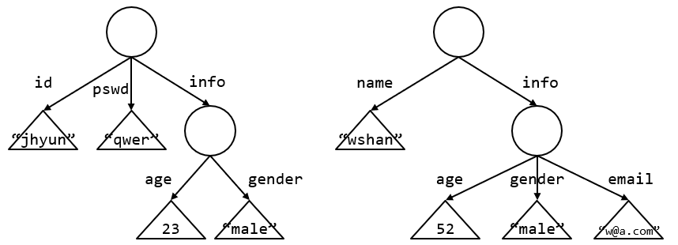
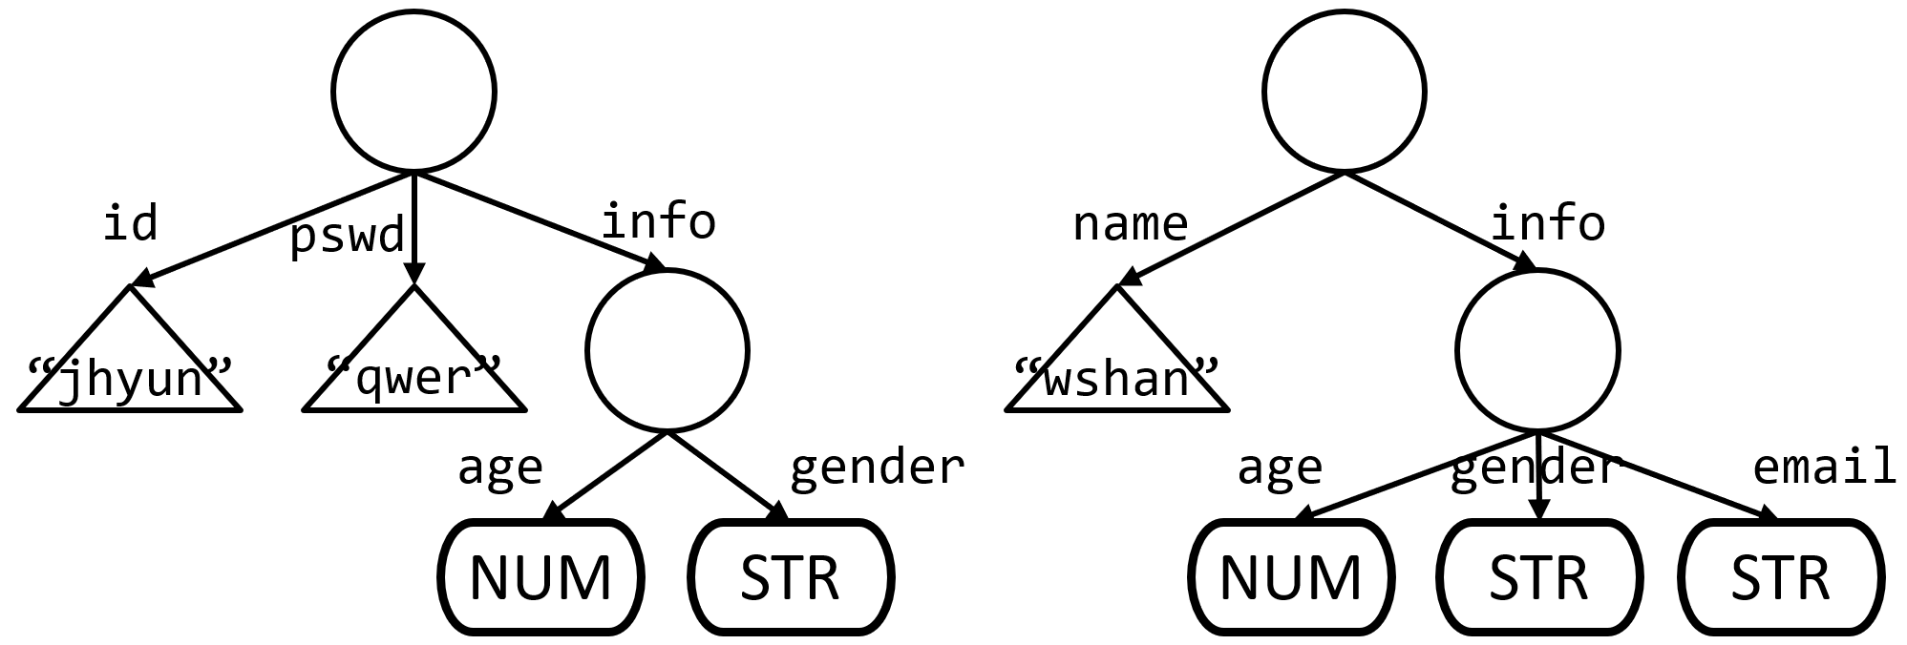
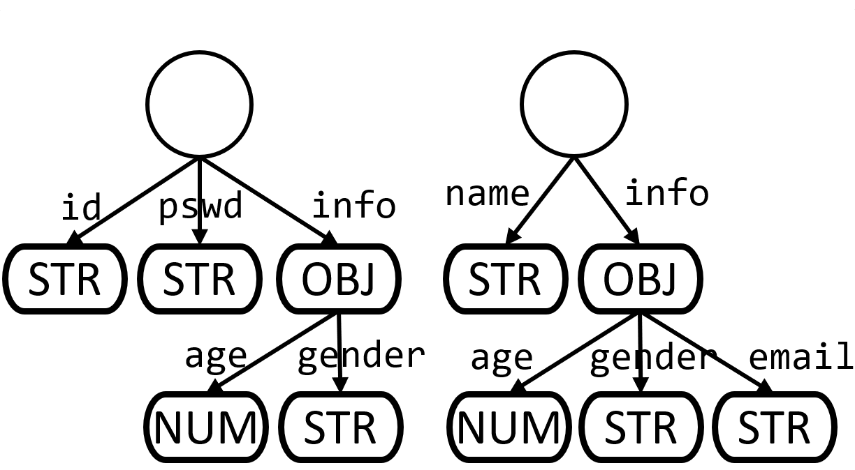
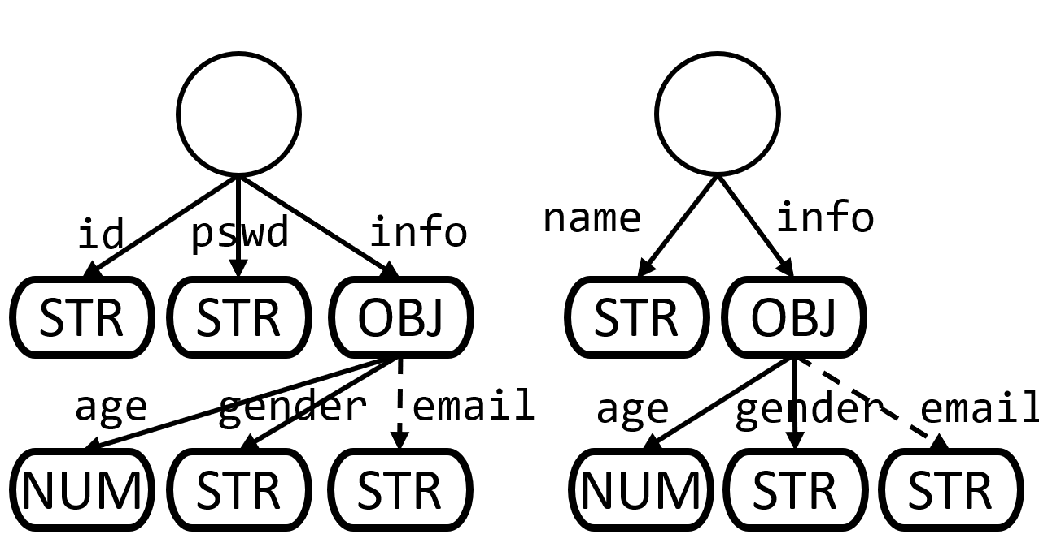
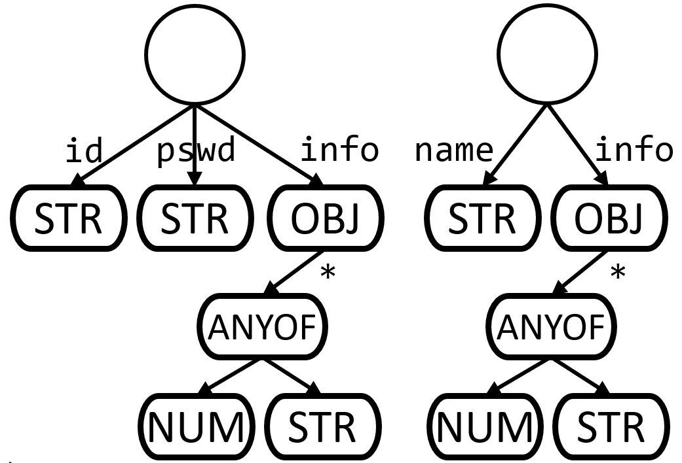

Key Idea 2: Candidate Schema Exploration
ReCG explores multiple schema derivation candidates rather than settling on just one.
Initial state:
Input JSON documents $D_{1}^{+}$
It is likely that a promising schema will
eixst within the candidate final states!
Candidate final states:
Fully derived schemas
* The schemas within the candidate final states are not expressed for brevity.

Slide 33



Motivation 3: Ambiguity in Choosing the Best Schema
We need a metric that correctly measure the “goodness” of a schema.
$$S_{1}$$
$$S_{2}$$
$$S_{3}$$
* The schemas within the candidate final states are not expressed for brevity.

Slide 34



Motivation 3: Ambiguity in Choosing the Best Schema
We need a metric that correctly measure the “goodness” of a schema.
$$S_{1}$$
$$S_{2}$$
$$S_{3}$$
ANYOF
OBJ
OBJ
*
OBJ
OBJ
ANYOF
id
pswd
name
info
id
pswd
info
name
info
STR
STR
STR
OBJ
STR
OBJ
STR
STR
OBJ
STR
OBJ
*
age
gender
age
gender
email
ANYOF
age
gender
email
NUM
STR
NUM
STR
STR
NUM
STR
STR
NUM
STR

Slide 35
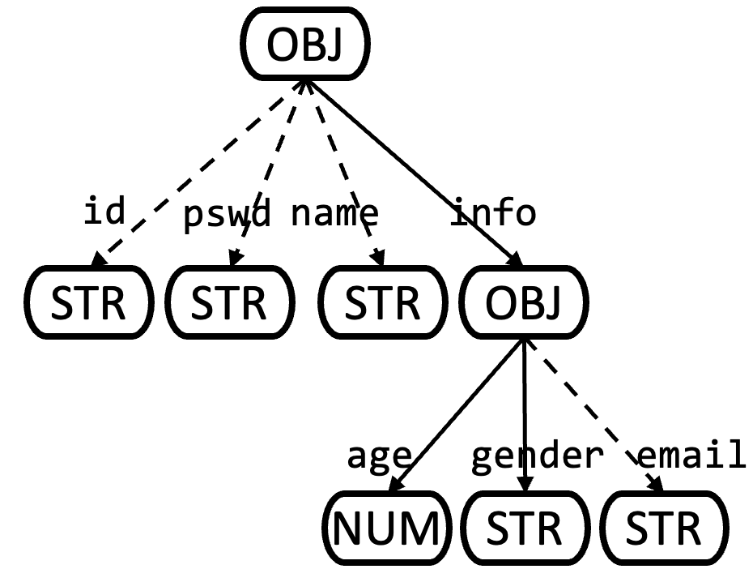
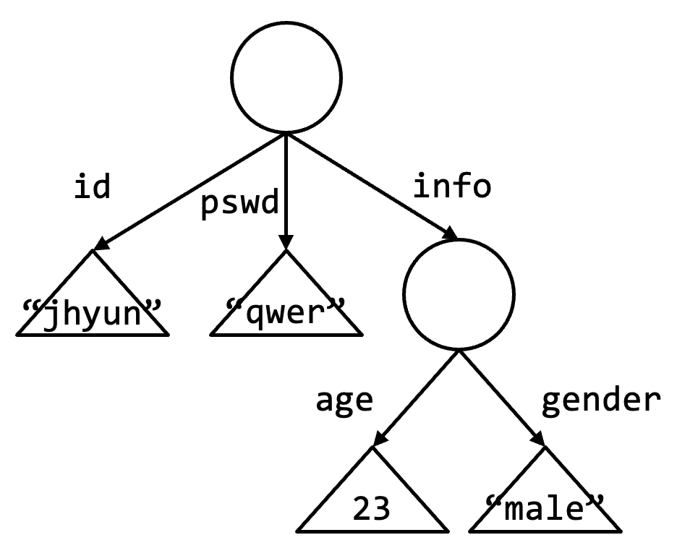
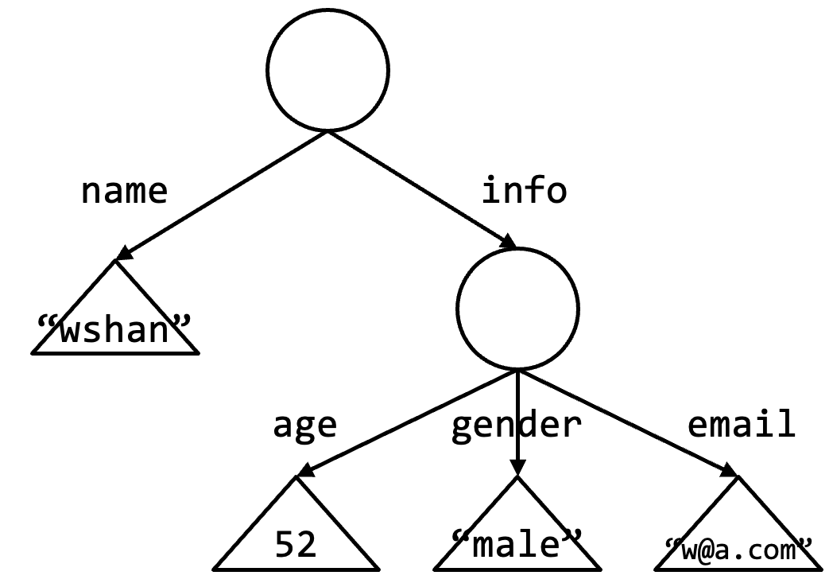


Key Idea 3: Minimum Description Length Cost
Minimum description length principle: minimize the total amount of information required to describe the input data
$$S$$
SRC: Schema representation cost
DRC: Data representation cost
transform
transform
$$D^{+}$$

Slide 36
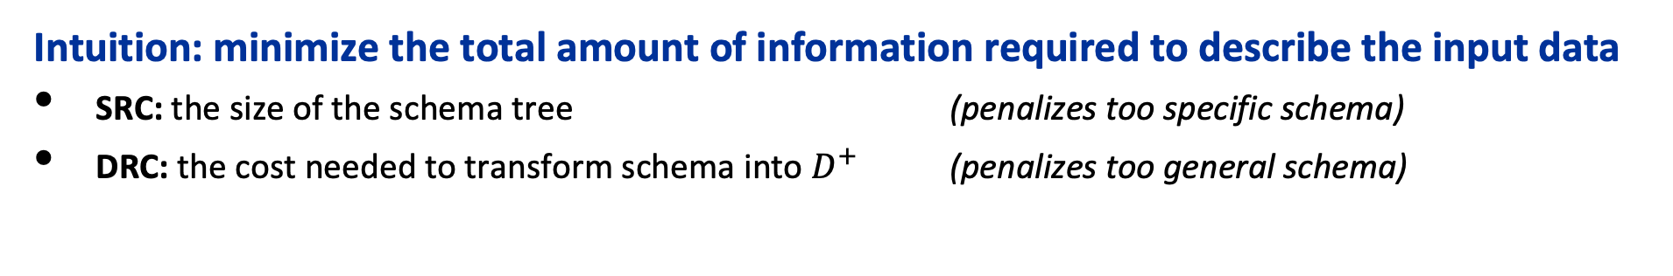


Key Idea 3: Minimum Description Length Cost
Intuition: minimize the total amount of information required to describe the input data
SRC: the size of the schema tree (penalizes too specific schema)
DRC: the cost needed to transform schema into $D^{+}$ (penalizes too general schema)
$$S_{2}$$
$$S_{3}$$
$$S_{1}$$
$$S_{D}$$
ANYOF
OBJ
OBJ
*
OBJ
OBJ
ANYOF
id
pswd
name
info
id
pswd
info
name
info
STR
STR
STR
OBJ
STR
OBJ
STR
STR
OBJ
STR
OBJ
*
age
gender
age
gender
email
ANYOF
age
gender
email
NUM
STR
NUM
STR
STR
NUM
STR
STR
NUM
STR
SRC ↑
SRC -
SRC ↓
DRC ↓
DRC -
DRC ↑

Slide 37
Contributions of ReCG
46% higher F1 score while also performing 2.11× faster on average against the state-of-the-art algorithm
Bottom-up schema generation
Search for schema candidate
Minimum description length cost

Slide 38
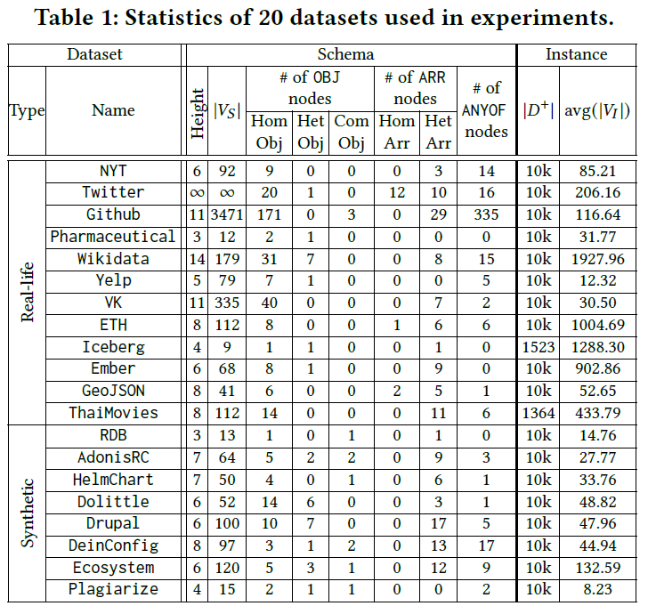
Experiment
Algorithms compared
Jxplain (SOTA), KReduce, LReduce, KSS (Kletteke et al.), FMC (Frozza et al.)
Machine
Intel Xeon E5-2680 v4 @2.40GHz CPU and 756 GB RAM
Datasets
.

Slide 39
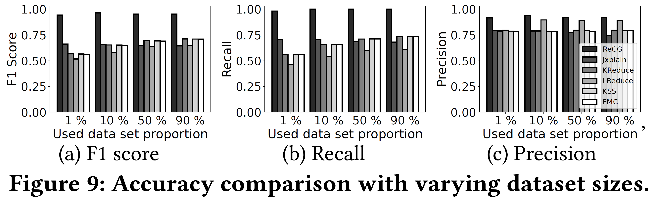
Accuracy Comparison
46%
47%
18%
ReCG outperforms all competitors in F1 score, especially shows 46% increase compared to the SOTA
Shows upto 47% higher recall compared to SOTA
Shows upto 18% higher precision compared to SOTA

Slide 40
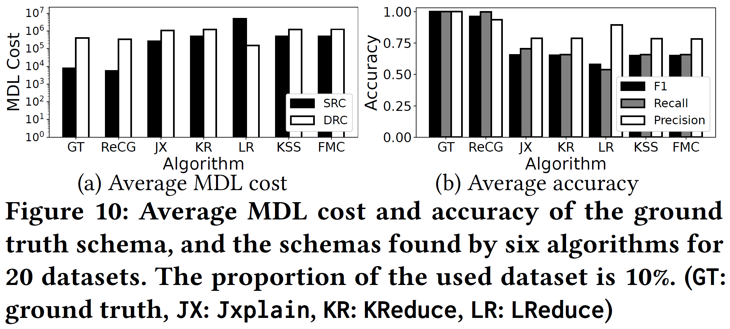
MDL Cost Analysis
4.9×
14.2×
3.8×
ReCG’s MDL cost is 3.8×, 4.9× and 14.2× smaller than Jxplain, KReduce, and LReduce, respectively.
MDL costs show a strong negative correlation (-0.77) with F1 scores.

Slide 41
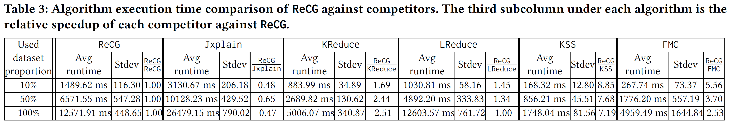
Algorithm Execution Time
ReCG’s performance is positioned in the middle of KReduce and Jxplain
ReCG outperforms Jxplain by 1.54× to 2.11× on average varying on dataset size
ReCG is slower than KReudce by about 2×
ReCG spends time searching for various candidates of schema
More experiments in our paper!

Slide 42
Conclusion
We present an accurate and efficient JSON schema discovery algorithm called ReCG
ReCG solves the accuracy problems of existing algorithms
We propose the novel concept of bottom-up schema generation to provide more information within the schema derivation process
We solve the JSD problem as a search problem, while applying the minimum description length principle to choose the most promising schema

Slide 43
THANK YOU

